Slide 1

IE 260 – ENGINEERING ECONOMY Chapter 1 Introduction to Engineering Economy
U. MAHİR YILDIRIM

Slide 2
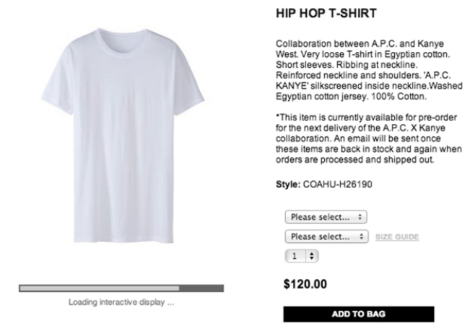

Introduction
The purpose of this course is to develop and illustrate the principles and methodology required to answer the basic economic question of any design:
Do its benefits exceed its cost?

Slide 3
Chapter 1
The purpose of Chapter 1 is to present the concepts and principles of engineering economy.

Slide 4

Engineering Economy
Involves the systematic evaluation of the economic merits of proposed solutions to engineering problems.

Slide 5
Engineering Economy (cont’d)
To be economically acceptable (i.e., affordable), solutions to engineering problems must demonstrate a positive balance of long-term benefits over long-term costs, and they must also
Promote the well-being and survival of an organization,
Embody creative and innovative technology and ideas
Permit identification and scrutiny of their estimated outcomes, and
Translate profitability to the “bottom line” through a valid and acceptable measure of merit

Slide 6
Engineering Economy (cont’d)
Decisions that engineers make or recommend as they work to position a firm to be profitable in a highly competitive marketplace.
Trade-offs among different types of costs and the performance provided by the proposed design or problem solution.
The mission of engineering economy is to balance these trade-offs in the most economical manner

Slide 7
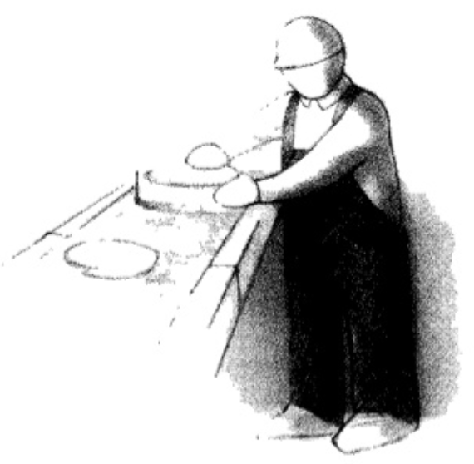


Trade-offs
A trade-off (or tradeoff) is a situation that involves losing one quality or aspect of something in return for gaining another quality or aspect.
Engineering economy can provide an answer.
Should a company buy equipment to perform an operation now done manually?
Is now the time to replace the old machine?
Should a company spend money now in order to save more money later?
If not, when is the right time to replace the old equipment?
Cost reduction decision
Replacement decision: Is it worth fixing or replacing ?

Slide 8
Engineering economic analysis can play a role in many types of situations:
Choosing the best design for a high-efficiency gas furnace
Selecting the most suitable robot for a welding operation on an automotive assembly line
Making a recommendation about whether jet airplanes for an overnight delivery service should be purchased or leased
Determining the optimal staffing plan for a computer help desk

Slide 9
There are seven fundamental principles of engineering economy
Develop the alternatives
Focus on the differences
Use a consistent viewpoint
Use a common unit of measure
Consider all relevant criteria
Make uncertainty explicit
Revisit your decisions
Notes:
The development, study, and application of any discipline must begin with a basic foundation.

Slide 10
Principle 1. Develop the alternatives
The alternatives need to be identified and then defined for subsequent analysis.
Creativity and innovation are essential
A trivial alternative ?
Making no change to the current operation or set of conditions (i.e., doing nothing).

Slide 11



Principle 2. Focus on the differences
Only the differences in expected future outcomes among the alternatives are relevant to their comparison and should be considered in the decision.
vs
Outcomes that are common to all alternatives can be disregarded in the comparison and decision.
The basic purpose of an engineering economic analysis: to recommend a future course of action based on the differences among feasible alternatives.

Slide 12
Principle 3. Use a consistent viewpoint
The prospective outcomes of the alternatives, economic and other, should be consistently developed from a defined viewpoint (perspective).
In private-sector analyses, the appropriate viewpoint is often that of business owners seeking profit.
Public-sector analyses are more complicated
With respect to transportation, the viewpoint is generally that of the public.

Slide 13
Principle 4. Use a common unit of measure
Using a common unit of measurement to enumerate as many of the prospective outcomes as possible will simplify the analysis of the alternatives.
Directly comparable (if possible)
Monetary unit
Outcomes that are not economic ?
Quantify if possible
Number of affected people
Else, describe these consequences explicitly so that the information is useful to the decision maker in the comparison of the alternatives.

Slide 14
Principle 5. Consider all relevant criteria
The decision process should consider both the outcomes enumerated in the monetary unit and those expressed in some other unit of measurement or made explicit in a descriptive manner.
In engineering economic analysis, the primary criterion relates to the long-term financial interests of the owners.
Other organizational objectives should be considered and given weight in the selection of an alternative.

Slide 15


Principle 6. Make uncertainty explicit
Risk and uncertainty are inherent in estimating the future outcomes of the alternatives and should be recognized in their analysis and comparison.
Future cash receipts and expenses
Hurricane Sandy 2012

Slide 16
Principle 7. Revisit your decisions
The initial projected outcomes of the selected alternative should be subsequently compared with actual results achieved.
Undesirable outcome
Results significantly different from the initial estimates of the consequences

Slide 17
Engineering economic analysis procedure
Problem definition
Development of alternatives
Development of prospective outcomes
Selection of a decision criterion
Analysis and comparison of alternatives
Selection of the preferred alternative
Performance monitoring and post-evaluation of results

Slide 18
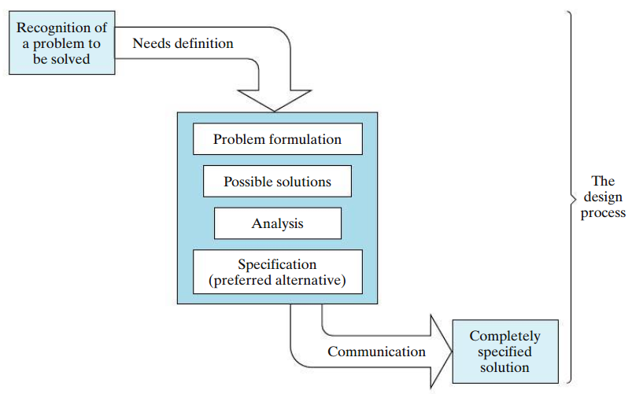
Engineering Design Process
Step 1
Step 2
Step 3
Step 4
Step 5
Step 6

Slide 19
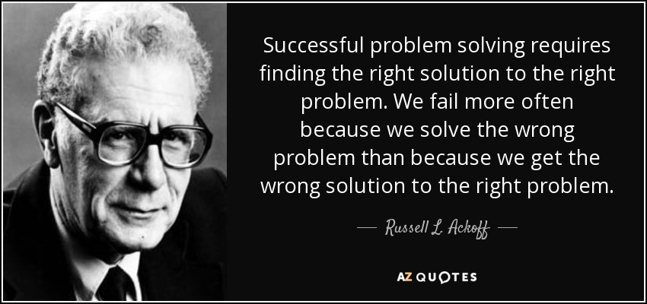

Slide 20
Engineering Design Process Problem Definition
A problem must be well understood and stated in an explicit form before the project team proceeds with the rest of the analysis.
Evaluation of the problem includes refinement of needs and requirements.
Redefining the problem until a consensus is reached may be the most important part of the problem-solving process!

Slide 21
Engineering Design Process Development of Alternatives
Two primary actions;
searching for potential alternatives and,
screening them to select a smaller group of feasible alternatives for detailed analysis
Creativity is essential
Several limitations exist;
lack of time and money,
preconceptions of what will and what will not work, and
“… The Wrights stated they would furnish a machine for $25,000 in 200 days that would fly at a speed of 40 mph with two men aboard. … As soon as the specifications were announced, newspapers across the country criticized the move as a waste of taxpayers’ money. “
lack of knowledge

Slide 22
Example Defining the Problem and Developing Alternatives
The management team of a small furniture-manufacturing company is under pressure to increase profitability to get a much-needed loan from the bank to purchase a more modern pattern-cutting machine. One proposed solution is to sell waste wood chips and shavings to a local charcoal manufacturer instead of using them to fuel space heaters for the company’s office and factory areas.
Define the company’s problem. Next, reformulate the problem in a variety of creative ways.

Slide 23
Solution Defining the Problem and Developing Alternatives
The company’s problem appears to be that revenues are not sufficiently covering costs. Several reformulations can be posed:
The problem is to increase revenues while reducing costs.
The problem is to maintain revenues while reducing costs.
The problem is an accounting system that provides distorted cost information.
The problem is that the new machine is really not needed (and hence there is no need for a bank loan)

Slide 24
Engineering Design Process Development of Prospective Outcomes
Cash-flow approach
Net cash flow
The difference between all cash inflows (receipts or savings) and cash outflows (costs or expenses) during each time period
Nonmonetary factors
Meeting or exceeding customer expectations
Safety to employees and to the public
Improving employee satisfaction
Maintaining production flexibility to meet changing demands
Meeting or exceeding all environmental requirements
Achieving good public relations or being an exemplary member of the community …

Slide 25
Engineering Design Process Selection of a Decision Criterion
Incorporates Principle 5 (consider all relevant criteria).
The decision maker will select the alternative that will best serve the long-term interests of the owners of the organization.

Slide 26
Engineering Design Process Analysis and Comparison of Alternatives
Based on cash-flow estimates for the feasible alternatives selected for detailed study
When cash flow and other required estimates are eventually determined, alternatives can be compared based on their differences as called for by Principle 2.
Usually, these differences will be quantified in terms of a monetary unit such as dollar

Slide 27
Engineering Design Process Selection of the Preferred Alternative
When the first five steps of the engineering economic analysis procedure have been done properly, the preferred alternative (Step 6) is simply a result of the total effort.

Slide 28
Engineering Design Process Performance Monitoring and Postevaluation of Results
This final step implements Principle 7 and is accomplished during and after the time that the results achieved from the selected alternative are collected.
Monitoring project performance during its operational phase improves the achievement of related goals and objectives and reduces the variability in desired results.

Slide 29

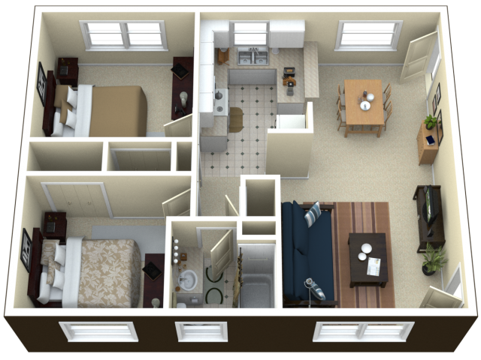
Example Application of the Engineering Economic Analysis Procedure
A friend of yours bought a small apartment building for $100,000 in a college town. She spent $10,000 of her own money for the building and obtained a mortgage from a local bank for the remaining $90,000. The annual mortgage payment to the bank is $10,500. Your friend also expects that annual maintenance on the building and grounds will be $15,000. There are four apartments in the building that can each be rented for $360 per month.
Refer to the seven-step procedure to answer the following questions:
Notes:
A quick set of calculations shows that your friend does indeed have a problem.Alotmoremoney is being spent by yourfriend each year($10,500 + $15,000 = $25,500) than is being received (4 × $360 × 12 = $17,280). The problem could be that the monthly rent is too low. She’s losing $8,220 per year. (Now, that’s a problem!)
c) Option (1). Raise total monthly rent to $1,440+$R for the four apartments to cover monthly expenses of $2,125. Note that the minimum increase in rent would be ($2,125 - $1,440)/4 = $171.25 per apartment per month (almost a 50% increase!).

Slide 30
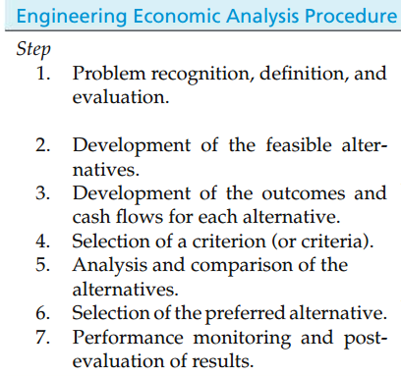
Example (cont’d) Application of the Engineering Economic Analysis Procedure
Does your friend have a problem? If so, what is it?
What are her alternatives? (Identify three.)
Estimate the economic consequences and other required data for the alternatives in Part (b).
Select a criterion for discriminating among alternatives, and use it to advise your friend on which course of action to pursue.
Attempt to analyze and compare the alternatives in view of at least one criterion in addition to cost.
What should your friend do based on the information you and she have generated?

Slide 31
Electronic spreadsheets are a powerful addition to the analysis
Most engineering economy problems can be formulated and solved using a spreadsheet (an interactive computer application for organization, analysis and storage of data in tabular form)
Large problems can be quickly solved
Proper formulation allows key parameters to be changed
Graphical output is easily generated

Slide 32
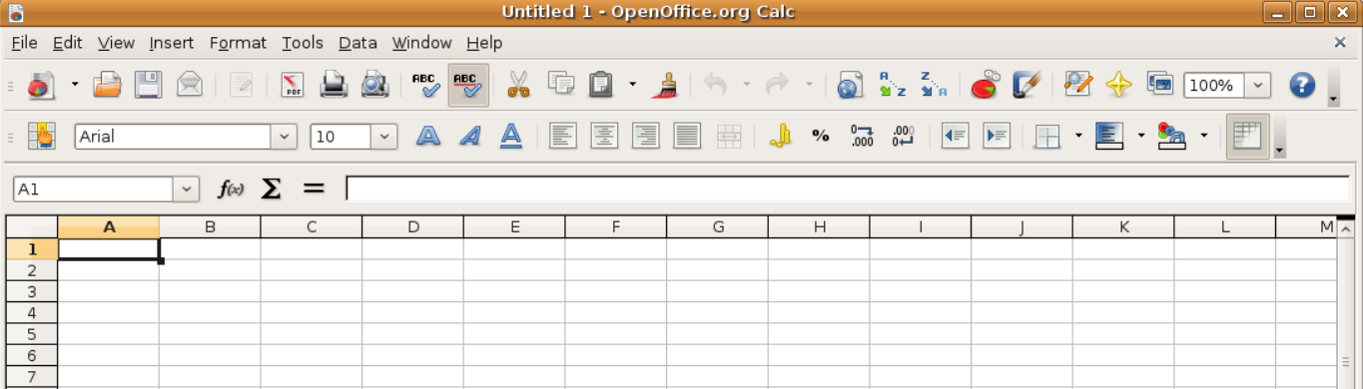
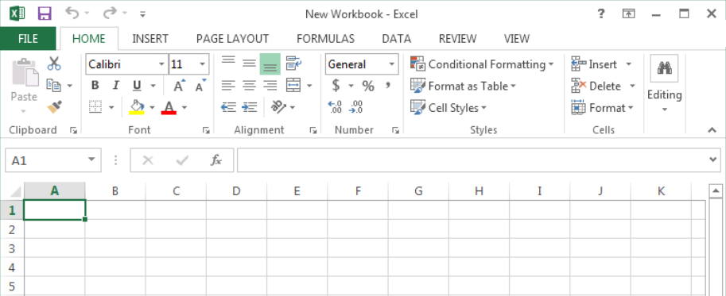
Some electronic spreadsheets
OpenOffice.org Calc spreadsheet
Microsoft Office Excel

